Slide 1
3-DAY CAPSTONE PROJECT
Food Delivery
Data Warehouse
& Analytics Platform
End-to-End Data Engineering: SQL · ETL · Python · Visualization
Sprint 1: SQL & Schema Design | Sprint 2: Data Warehouse & ETL | Sprint 3: Python Analytics

Slide 2
PROJECT OVERVIEW
Business Scenario & Objectives
Business Scenario
DAY 1
SQL & Schema
A nationwide food delivery company operating across multiple cities wants to build a centralized Delivery Data Warehouse to derive operational and customer insights.
Star schema design, analytical KPI queries, schema validation
DAY 2
DW & ETL
Design the warehouse model for orders & deliveries
Dimensional modeling, full + incremental ETL, SCD Type 2, PII masking
Develop Full + Incremental ETL pipelines
Implement SCD Type 2 for historical tracking
DAY 3
Python & Visualization
Perform analysis and build dashboards with Python
Pandas analytics, Matplotlib dashboards, query optimization
Source Tables: customers · restaurants · couriers · orders · order_items · deliveries

Slide 3
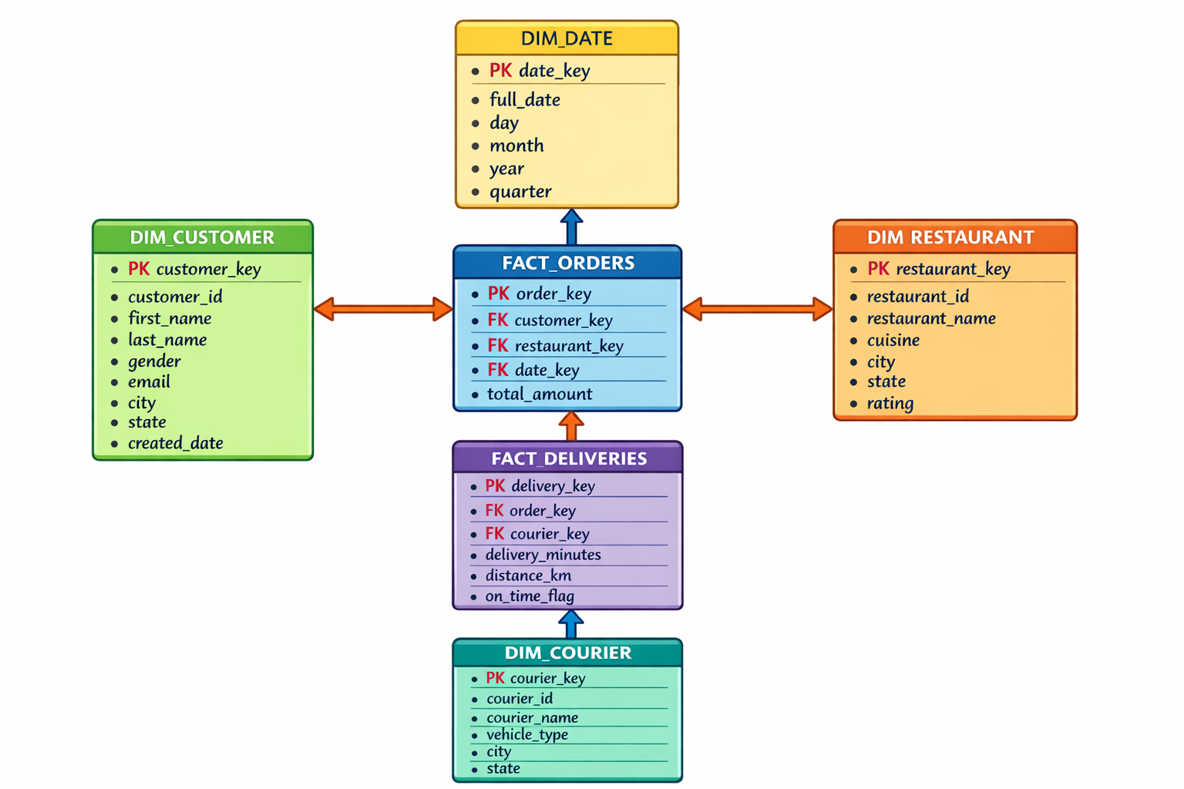
DAY 1 — SQL DATA ANALYSIS
Star Schema Design

Slide 4
DAY 1 — ANALYTICAL SQL QUERIES
Key Performance Indicators & Business Metrics
💰 Average Order Value (AOV)
⏱️ Delivery Fulfillment Time
Aggregate revenue ÷ total orders, segmented by city and cuisine type. Identify high-value market segments.
Avg minutes from order placement to doorstep delivery. Computed per courier, city, and time-of-day bucket.
✅ On-Time Delivery Rate
🏆 Top Cuisines & Cities by Revenue
% of deliveries completed within SLA window. Broken down by courier and restaurant to spot bottlenecks.
Ranked revenue contribution using window functions. Enables regional marketing and menu optimization.
🔄 Customer Retention Rate
🚴 Courier Performance Score
Repeat order frequency analysis — identifies loyal cohorts vs. churned users using cohort SQL patterns.
Composite score: avg delivery time + on-time % + customer rating. Flags underperforming couriers.
Also includes: Schema validation, referential integrity checks, and join correctness tests

Slide 5
DAY 2 — DATA WAREHOUSING + ETL PIPELINE
Warehouse Architecture & Dimensional Model
SOURCE
TRANSFORM
DATA WAREHOUSE
ANALYTICS
customers
Data Cleansing
dim_customer
restaurants
Type Casting
dim_restaurant
SQL Queries
couriers
SCD Type 2
dim_courier
Extract
Load
Analyze
Pandas DFs
orders
PII Masking
dim_date
order_items
Error Handling
dim_location
Matplotlib
deliveries
Audit Logging
fact_orders
KPI Reports
fact_deliveries

Slide 6
DAY 2 — ETL DEVELOPMENT
Full Load · Incremental Load · SCD Type 2
Full ETL Load
Incremental ETL
SCD Type 2
Truncate and reload all DW tables
Detect new/changed records via watermarks
Track historical dimension changes
Source → Extract → Clean → Load
Load only delta records since last run
Fields: customer_city, restaurant_type,
courier_phone, courier_rating
Baseline for dimension and fact tables
Timestamp-based and CDC approaches
Adds: effective_date, expiry_date,
is_current flag
Includes data type validation & null checks
Maintains ETL run log with audit trail
Preserves full history without data loss
🔒 PII Masking: Email → SHA-256 hash | Phone → Partially masked (last 4 visible) | Audit logs maintained per ETL run

Slide 7
DAY 3 — PYTHON ANALYTICS
Pandas Analysis + Matplotlib Visualization
📊 Analytical Metrics (Pandas)
📈 Visualization Suite (Matplotlib)
1
Monthly Orders & Revenue Trends
Line Chart
Monthly revenue & order trends
Line charts — seasonal patterns & growth
2
Avg Delivery Time by City & Cuisine
Bar Chart
Revenue by city & cuisine
Identify bottlenecks geographically
3
Customer Churn & Repeat Order Rates
Pie Chart
Order status distribution
Cohort analysis — 30/60/90-day windows
4
Courier Utilization & Rating Analysis
Histogram
Delivery time distribution
Performance benchmarking per partner
5
Cancellation & Delay Patterns
Horizontal Bar
Top courier performance ranking
Root-cause analysis by restaurant & time

Slide 8
PROJECT DELIVERABLES
Summary of All Sprint Outputs
Day 1 Deliverables
Day 2 Deliverables
Day 3 Deliverables
✓
Star schema diagram (logical + physical)
✓
DW table creation SQL scripts
✓
Python notebook (.ipynb) with documented analysis
✓
Annotated analytical SQL queries
✓
Full ETL + Incremental ETL scripts + run logs
✓
5+ Matplotlib visualizations (line/bar/pie/hist)
✓
KPI results: AOV, fulfillment time, on-time rate
✓
SCD Type 2 implementation with test cases
✓
Optimization summary: indexing + vectorization
✓
Schema validation & join correctness tests
✓
Masked PII sample data + audit trail logs
✓
Final PowerPoint or PDF presentation
Final Presentation includes: findings summary · business insights · optimization recommendations

Slide 9
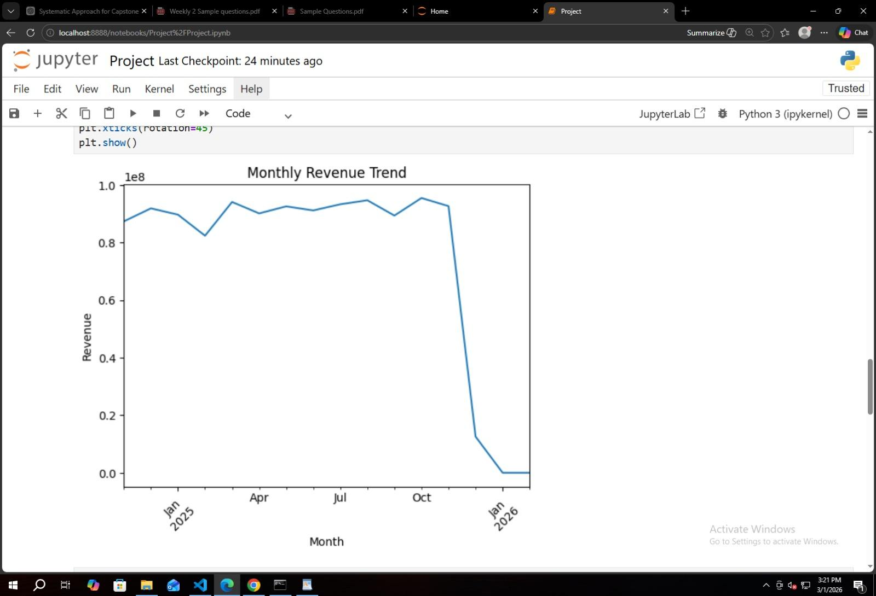

Slide 10
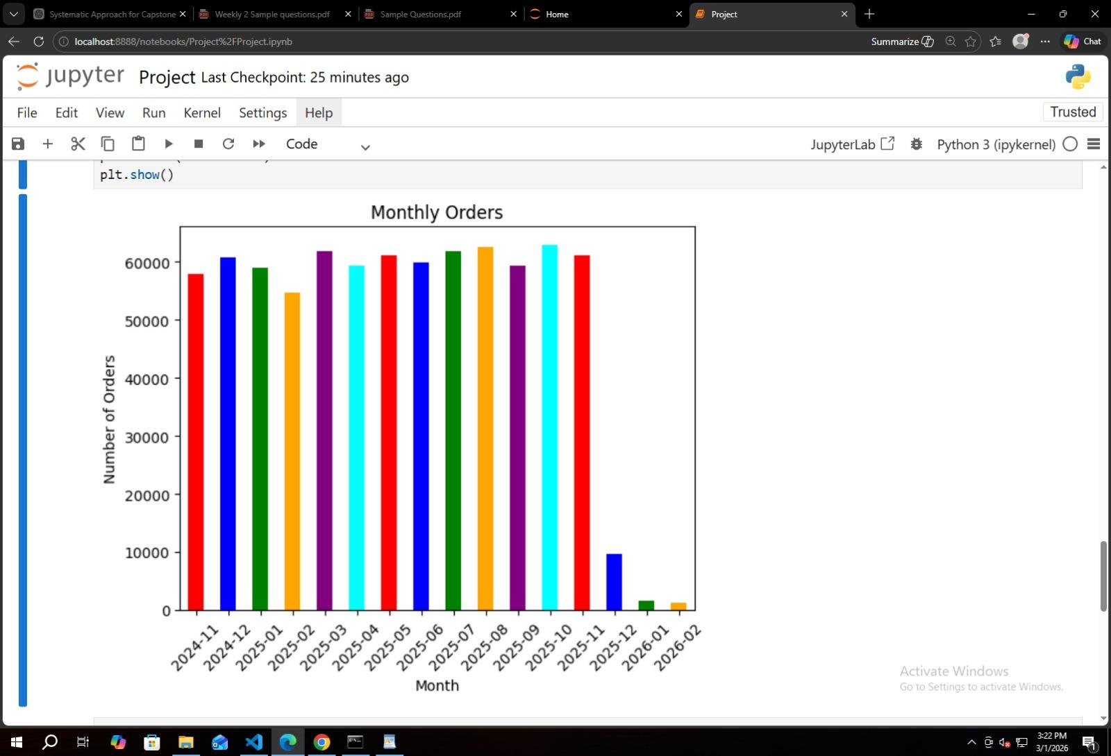

Slide 11
Key Takeaways
Delivering Enterprise-Grade
Data Engineering
🏗️ End-to-end warehouse design from OLTP to OLAP using star schema
⚙️ Production-quality ETL with Full, Incremental, and SCD Type 2 patterns
🔒 Data governance via PII masking and comprehensive audit logging
📊 Business intelligence through Python analytics and Matplotlib dashboards
🚀 Performance optimization via indexing, vectorization, and partitioning
Data Engineering Team · Food Delivery Data Warehouse Capstone

